Slide 1
USAG X HDAG Final Presentation
December 21, 2023
Cole, Omar W., Taj, Katherine, Emily, Anmay, Omar E.

Slide 2
Dashboard Overview
Brief introduction to the structure and design of the dashboard
Clustering/Classification Algorithms
Discussion of the methods we chose for our classification model
Visualizations
Selected screenshots of the dashboard.
Q/A
Plenty of time for questions at the end.
Notes:
Cole

Slide 3
Project Timeline
We have attempted to validate the accuracy of our classes, as we continue to refine our clusters
We will spend much of the rest of the semester developing a polished dashboard to wrap all our work
Validation
Dashboard
Classification
Data Analytics
Final Presentation
Classifying the plain-text squawk and action taken fields by class of issue.
We have begun and are continuing to develop visualization and statistical tests to visualize the data and get meaningful conclusions
By the end of the term we will have a fully polished web app dashboard to effectively visualize and understand the data
Notes:
Cole

Slide 4








Cole Harten
Omar Wahby
Omar Elshamy
Case Team Lead
Associate
Analyst
Anmay Gupta
Katherine Harvey
Emily McCallum
Taj Jethwani-Keyser
Analyst
Analyst
Analyst
Analyst
Notes:
Everyone–Name, Year, Concentration, Role

Slide 5
Project Objectives
1. Classification
2. Visualization and Stats Models
The first part of our work was centered primarily on developing a classification model to
classify the plain-text squawk reports.
We approached this through
converting an unsupervised approach
into a supervised, parametric model.
With the classification model in hand, we began working on the visualization to glean useful
information from the data. This used both
the classifications but also more
general correlational categories.
3. Database Integration
4. Visualization Dashboard
Finally, we will wrap all of these models
in a clean, simple user interface. This will
both limit technical barriers to understanding
the results and add much more dynamism to
the observations.
Next, after building these models, we
sought to integrate them with the entire db,
both to validate our models and to ultimately compute the general statistics of the entire dataset.
Notes:
Cole

Slide 6
Clustering
Data Clustering
We used agglomerative clustering to categorize the data into 256 clusters.
After extracting cluster keywords with KeyBERT, we reduced to 13 categories.
Then, we manually labeled each one using the keywords and JASC part definitions.
Class Evaluation
We performed a random sample of 100 labelled data points and verified them manually.
The (updated) unsupervised classifier is approximately 91% accurate.
By using more initial clusters (256 vs. 64), we were able to account for more component types in the general clusters.
E.g. alternator, suction gauge.
Notes:
Katherine

Slide 7
Classification Model
Model Creation
We fine-tuned the BERT-base-uncased deep learning model, which offers a good balance between speed and accuracy.
Steps: Encodes text input with BERT embeddings, passes through feed-forward neural network, and outputs prediction.
The model assigns a probability score to each prediction, but our dashboard implementation assigns sub-50% predictions to “misc.”
Model Evaluation
Accuracy | F1-Score
89.4% | 0.894
Notes:
Katherine

Slide 8
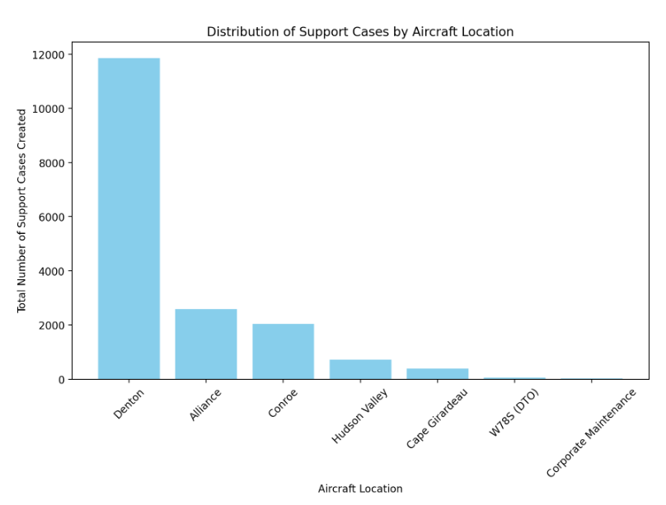
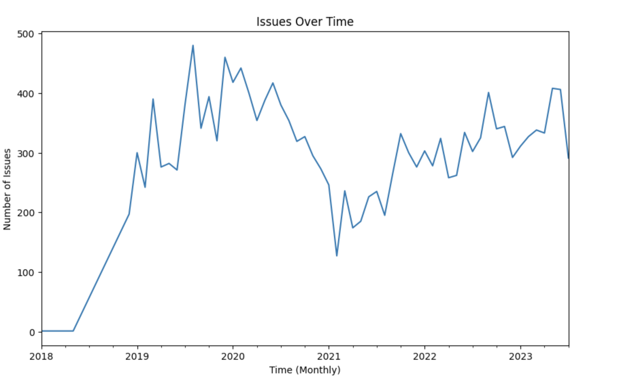
Initial Data Exploration
Initial observations within sample dataset of ~17500 support cases
Basic trends in location, time, aircraft type, etc. before applying normalization with flight activity
Plotted initial visualizations
Top 3 aircraft locations: Denton, Alliance, Conroe
Highest number of support cases (locations with most flight activity)
Fluctuations over time
Significant drop in 2020 (Covid)
Notes:
Emily

Slide 9
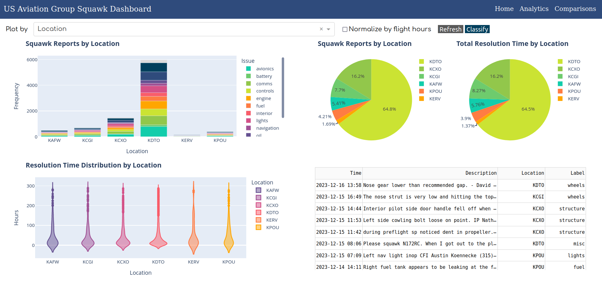
Dashboard Overview
Notes:
Wolfie

Slide 10

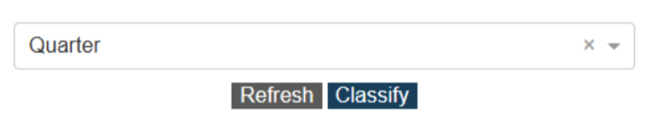
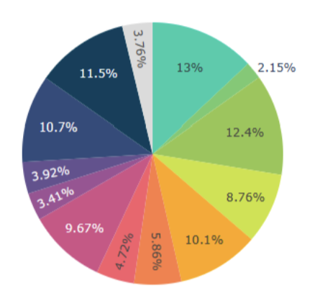
Dashboard Components
Graph Types
Stack bar charts displaying distribution of squawks per flight hour, per issue grouped by issue, location, aircraft type, and quarter.
Violin plot for resolution time (i.e., inspection lifetime) with the x-axis also determined by a selected dimension.
Pie chart to show the distribution of squawk reports by issue.
Other Features
Ability to normalize the graphs by flight hours.
Dynamically refresh data being displayed.
Dynamically classify data into one of 13 issue types.
Ability to deselect graphs categories, as well as other graph manipulation techniques built into Plotly.
Multiple pages containing various levels of detail.
Notes:
Wolfie

Slide 11
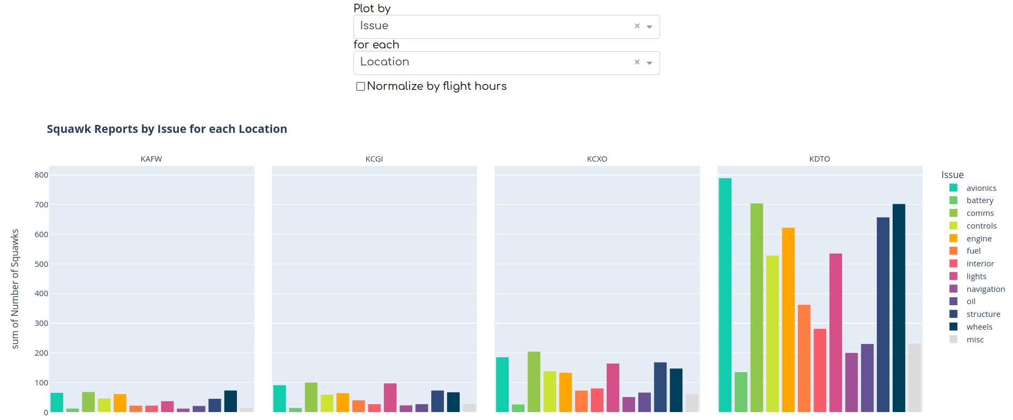
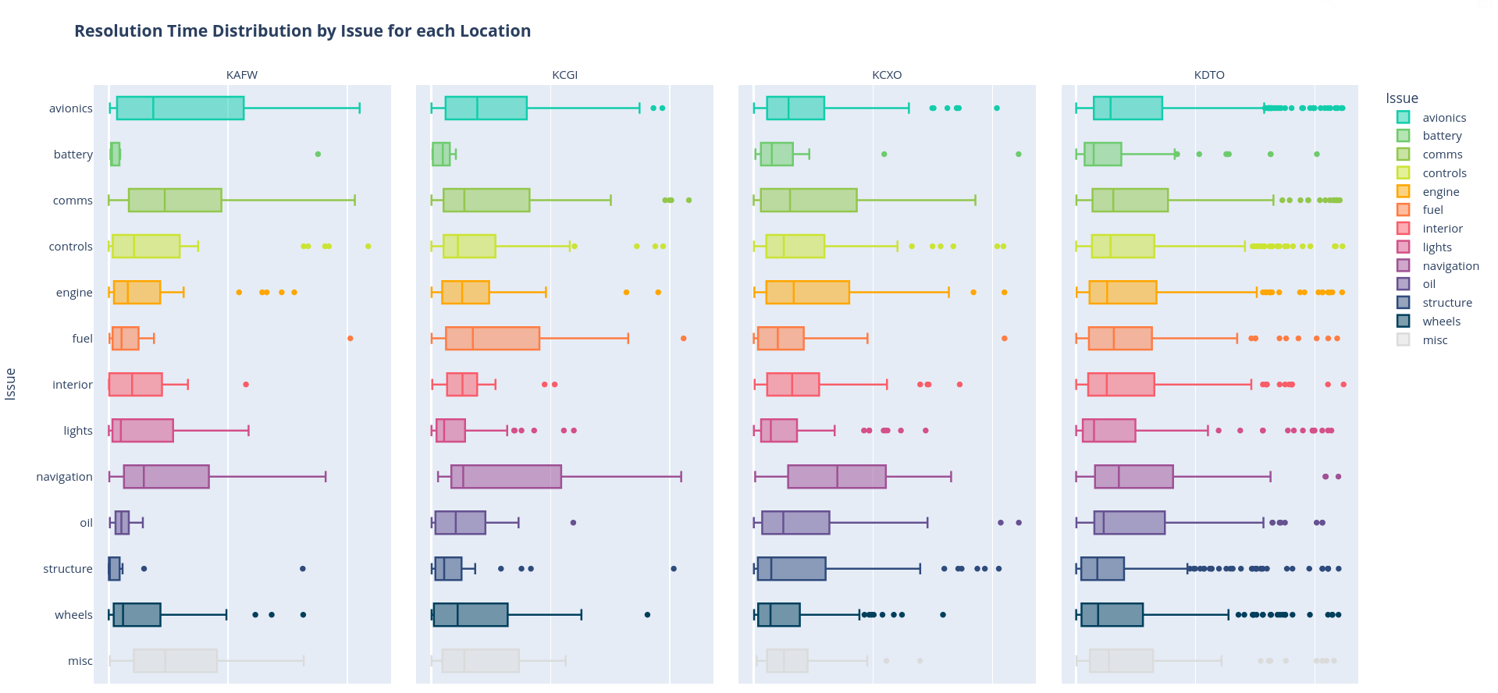
Detailed Views
Features
Faceted Bar charts displaying distribution of squawks per flight hour, per issue grouped by issue, location, aircraft type, and quarter.
Multiple box plots for resolution time (i.e., squawk lifetime) with the x-axis and graph facets also determined by a selected dimension
All graphs are completely customizable by the user to ensure maximum dashboard flexibility
Real-time analytics is supported, so dashboard always shows the latest updates on maintenance.
Notes:
Anmay

Slide 12
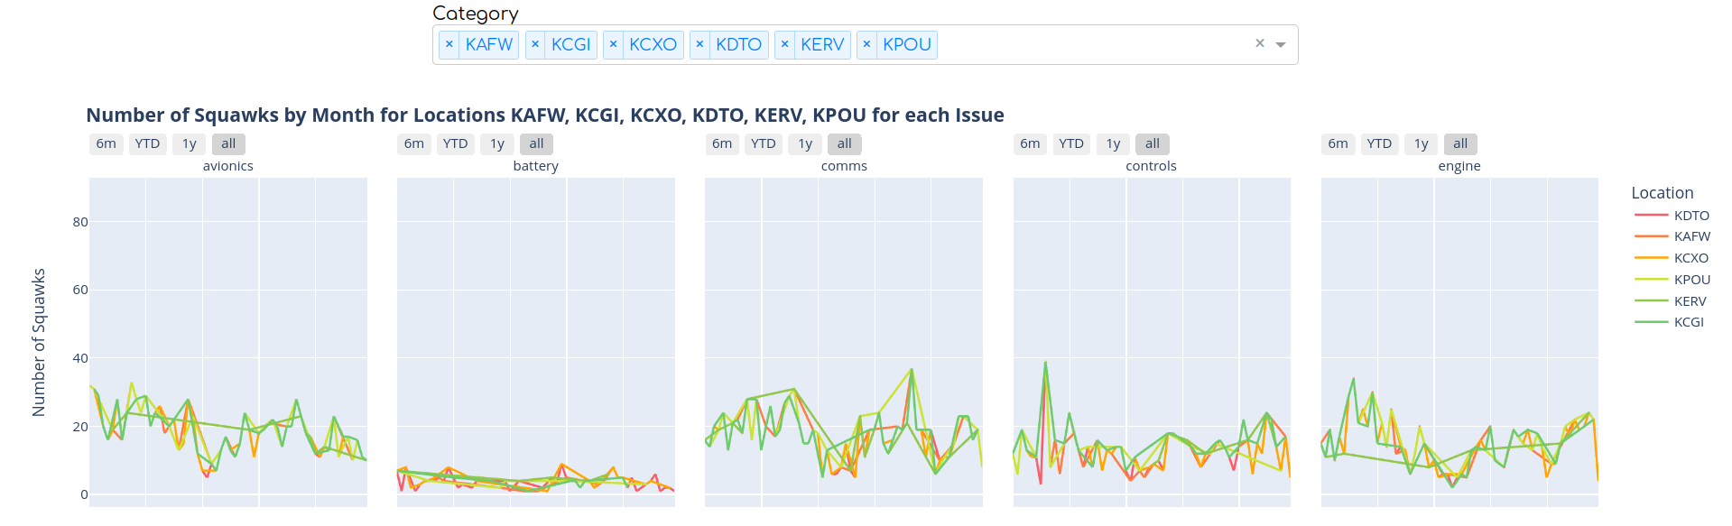
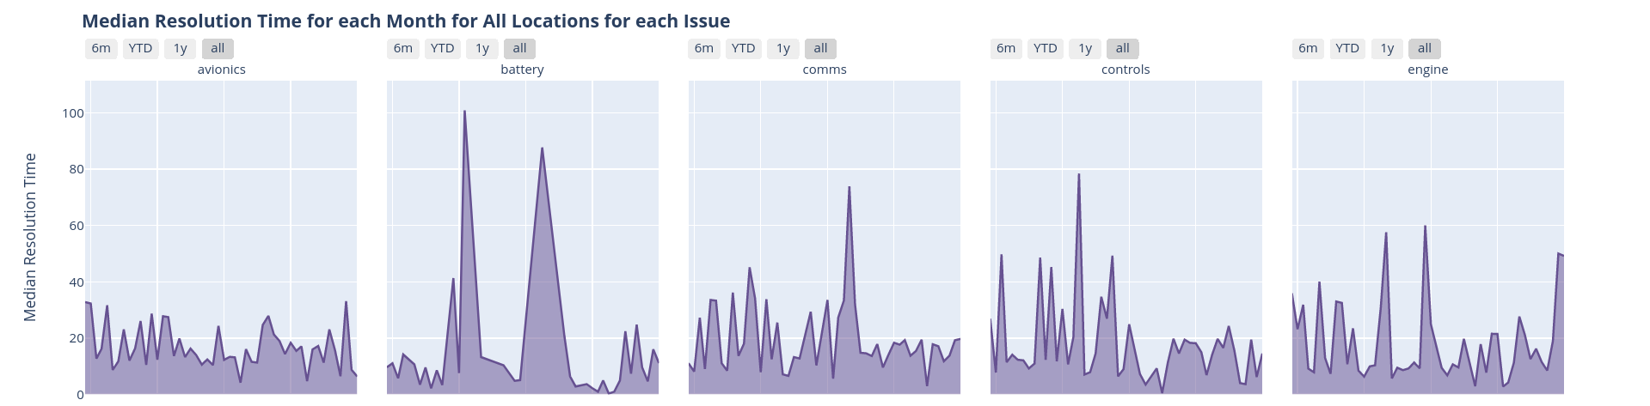
Dashboard Showcase
Notes:
Anmay

Slide 13
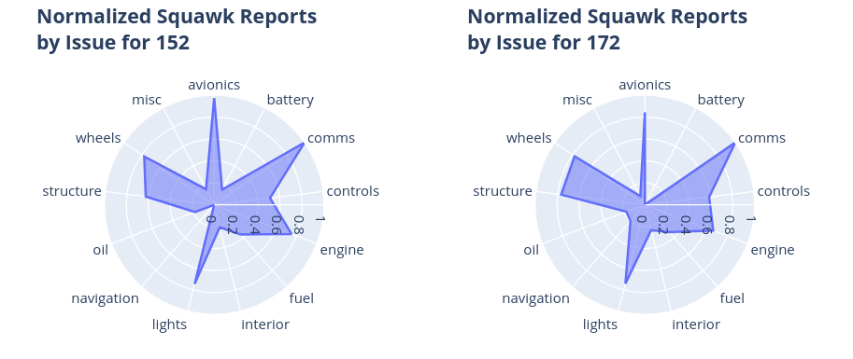
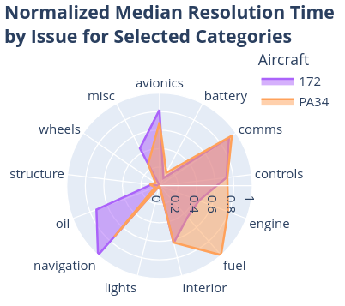
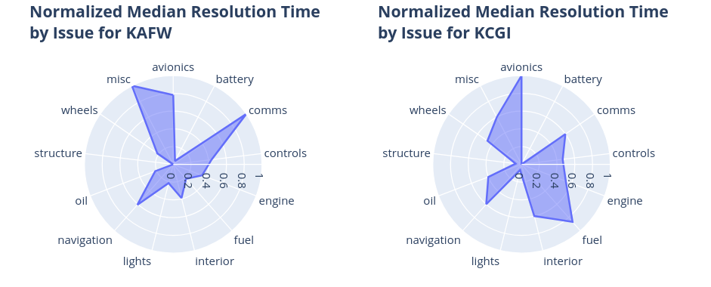
Dashboard Showcase
Notes:
Anmay

Slide 14
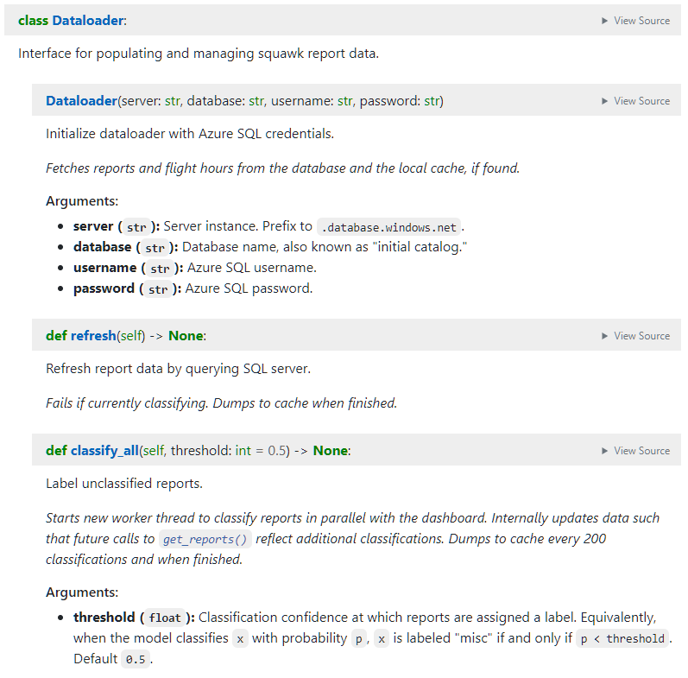
Dashboard API
In addition to the dashboard UI, we wrote documentation for all helpers and interfaces.
The “Dataloader” automatically fetches new report and flight-hour data from the SQL server.
Periodically, the data is cached locally so future requests are faster (and to avoid re-classification).
It is also performance-optimized to request and sort data as efficiently as possible.
Squawk classification is multithreaded, so the dashboard is still functional when classifying.
The visualization will refresh with newly-classified data each time you hit “refresh” in the app or call “Dataloader.refresh()” programmatically.
Classification can take up to 30 minutes the first time, but progress is maintained on app restart.
Notes:
Wolfie

Slide 15
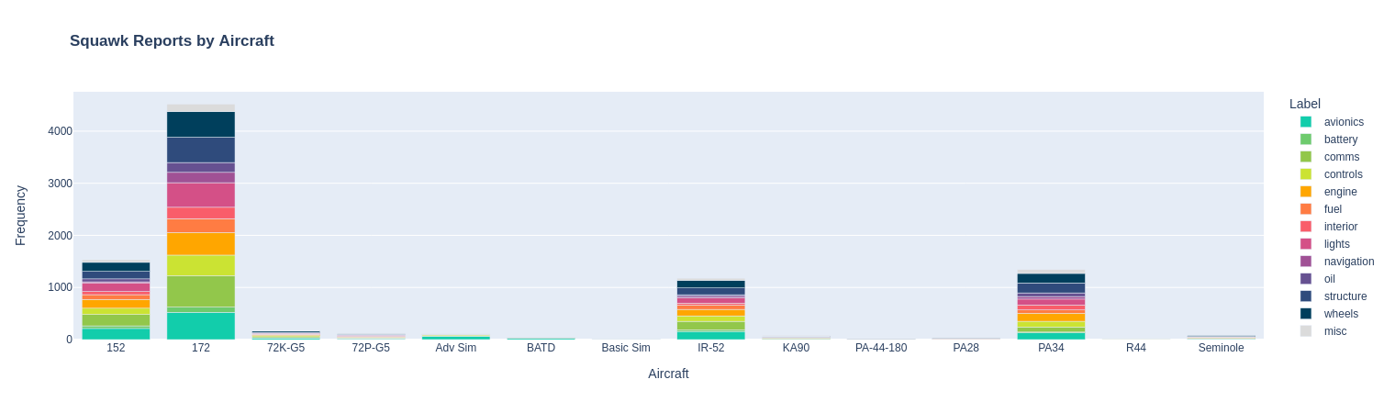
Unnormalized Aircraft Breakdown
Aircraft 172, 152, IR-52, and PA34 have the most squawk reports
Basic Sim, R44, and PA-44-180 have the smallest number of overall squawk reports
No category seems to be significantly larger than another. Largest categories include comms, avionics, wheels, and structures
Notes:
Katherine

Slide 16
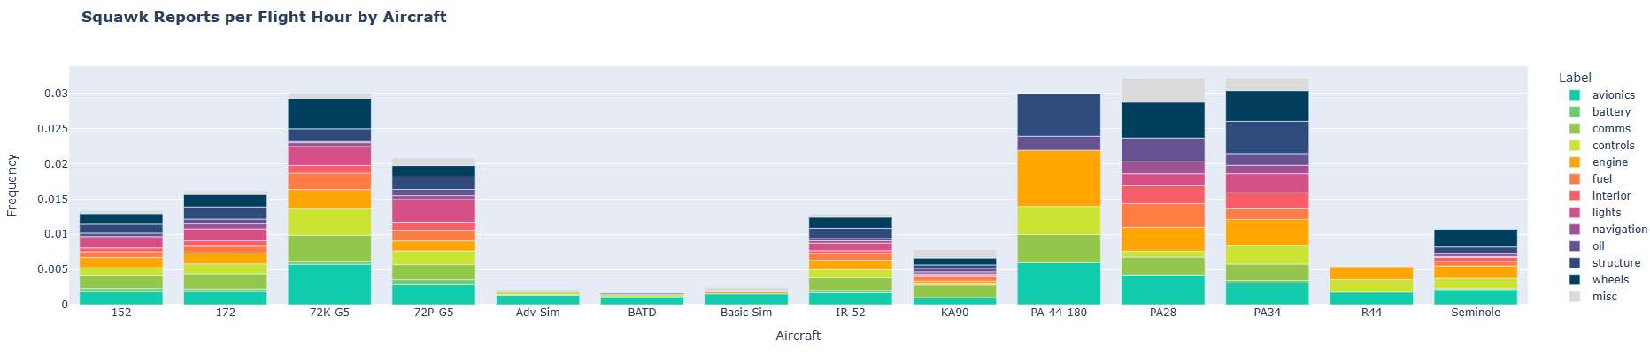
Normalized Aircraft Breakdown
After normalizing, we see that aircrafts 72K-G5, PA28, PA34, and PA-44-180 have the highest rate of squawks per flight hour
Unlike the other aircrafts, PA-44-180 doesn’t have issues with wheels and engine problems are its biggest category
Aircrafts Adv Sim, BATD and Basic Sim have low squawk reports in general and low reports per flight hour—which makes sense as simulators shouldn’t need structural repairs.
Notes:
Katherine

Slide 17
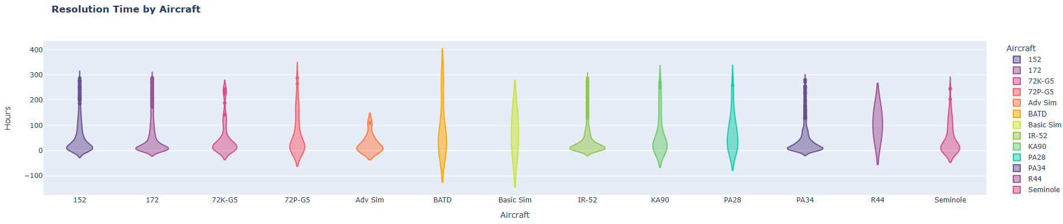
Unnormalized Aircraft Breakdown
Aircrafts 172, IR-52, and PA34 consistently demonstrated shorter resolution times compared to other aircraft types
Aircrafts BATD, Basic Sim, PA28, and R44 had a lower frequency of short resolution times
Adv Sim has low frequency of squawk reports (normalized and unnormalized) and high distribution of shorter resolution times, while BATD, Basic Sim, and R44 have a more broad distribution (for resolution time)
PA28 has one of the highest squawk reports per flight hour and one of the most inefficient averages for resolution time
Notes:
Katherine

Slide 18
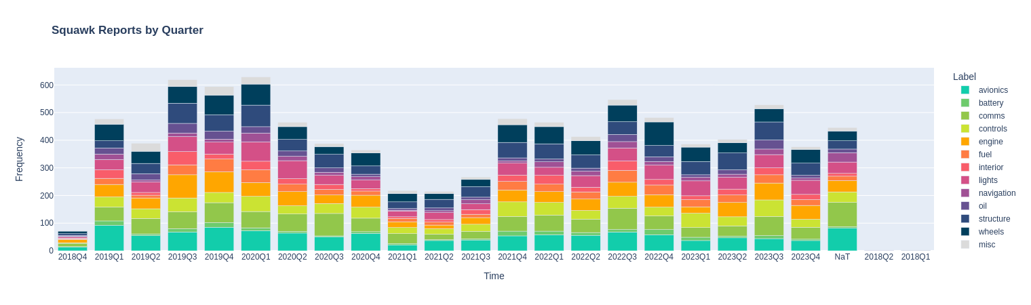
Unnormalized Quarterly Breakdown
2023 Q1 - 2023 Q4: Average frequency of about 425 squawk reports per quarter
Increase in frequency of squawks for controls and comms from 2023 Q2 to 2023 Q3
Return of squawk frequencies to pre-COVID levels
Notes:
Omar Wahby

Slide 19
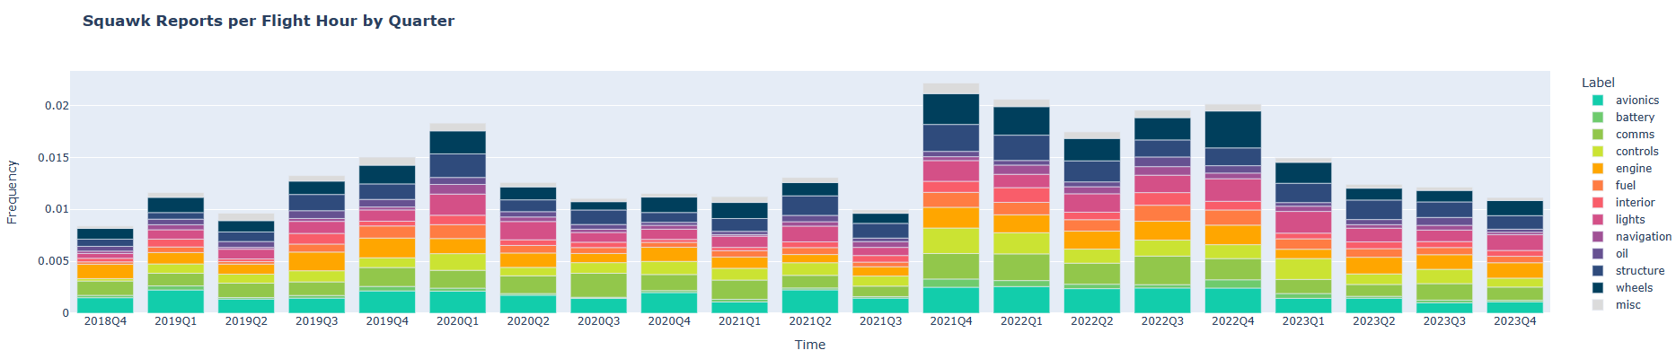
Normalized Quarterly Breakdown
Generally more stable than unnormalized quarterly breakdown
Confirms finding in normalized data: Increase in frequency of squawks for controls and comms from 2023 Q2 to 2023 Q3
2023 Q1 - 2023 Q4 shows convergence to a squawk reports frequency of 0.01 reports per flight hour
Notes:
Omar Wahby

Slide 20
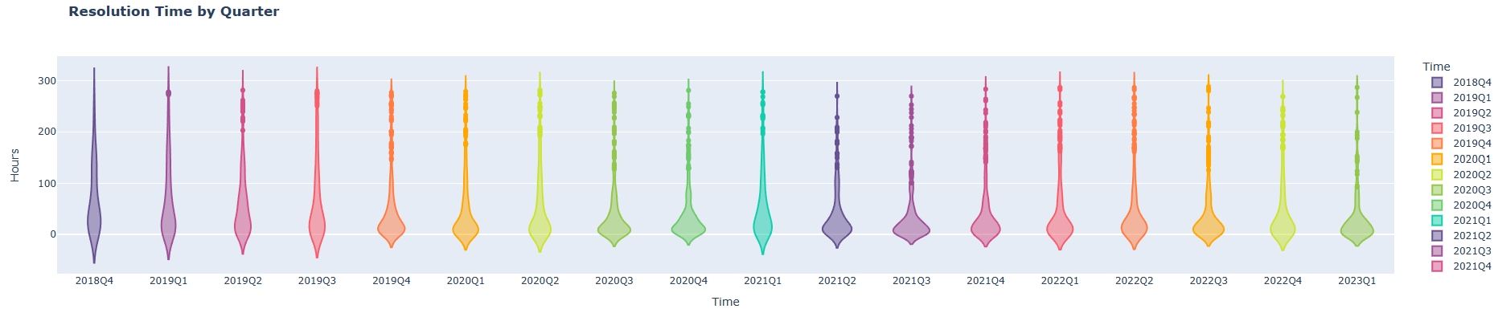
Resolution Time by Quarter
2022 Q4 - 2023 Q1: General decrease in resolution time
Significantly more efficient resolution time compared to pre-COVID
Minimum average resolution time: 2021 Q3
Notes:
Omar Wahby

Slide 21
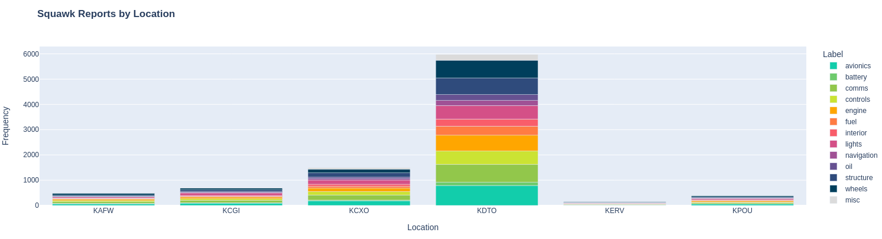
Unnormalized Location Breakdown
Alliance
Cape Girardeau
Conroe
Denton
Kerrville
Hudson Valley
Most squawk reports came out of KDTO (Denton), next highest out of KCXO (Conroe)
Smallest number of overall squawk reports - KERV (Kerrville)
Without normalization, chart suggests that KDTO (Denton) and KCXO (Alliance) were the busiest locations, and KERV (Kerrville) was the least busy - unable to pinpoint abnormal rates of squawks per flight hour before normalizing
Within breakdown of Denton’s squawks, no squawk class is significantly larger than the rest; most common are avionics, structure, wheels, comms
Notes:
Emily

Slide 22
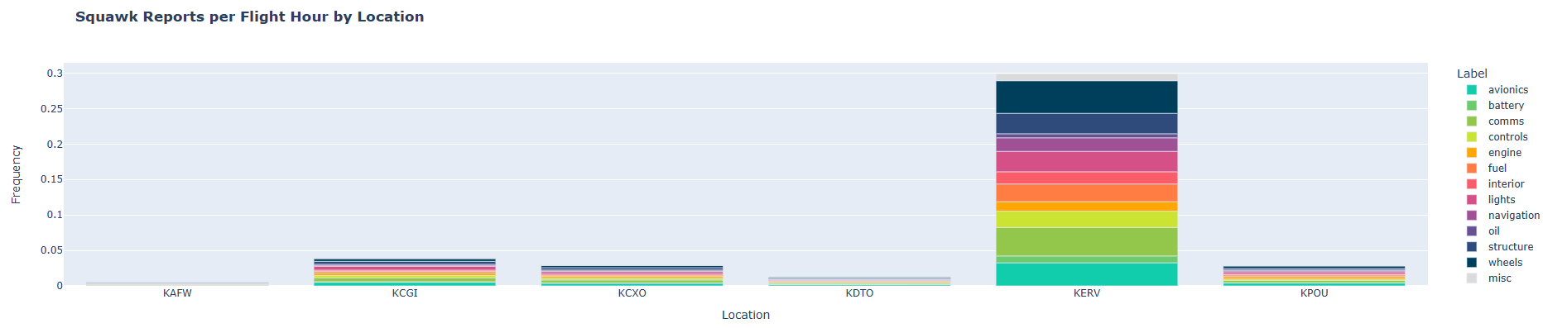
Normalized Location Breakdown
Alliance
Cape Girardeau
Conroe
Denton
Kerrville
Hudson Valley
After normalizing, Kerrville has highest rate of squawks per flight hour, despite having smallest total squawks
Denton also has one of the lowest rates of squawks per flight hour, despite having the largest total squawks
Many squawk reports contained within few flight hours - suggests the possibility of Kerrville’s aircraft having more maintenance issues than the average location
Within Kerrville’s breakdown - no specific class stands out as having significantly more than the rest; similar breakdown to Denton’s unnormalized breakdown
Notes:
Emily

Slide 23
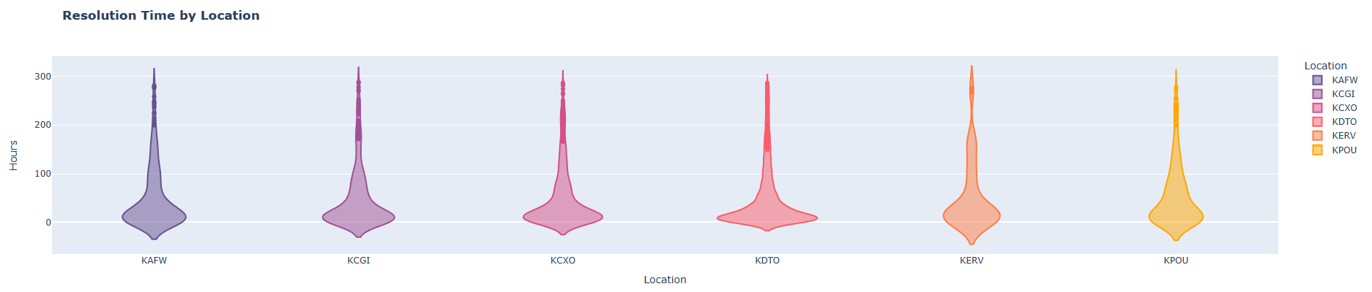
Resolution Time by Location
Alliance
Cape Girardeau
Conroe
Denton
Kerrville
Hudson Valley
Denton - most efficient location for resolving squawks (minimum average resolution time)
Denton is the busiest location - makes sense they would be more efficient
Conroe, Cape Girardeau, Alliance - seem approximately mid-range on efficiency
Hudson Valley and Kerrville - appear to have the most inefficient average resolution times (longest)
Kerrville - most squawks per flight hour along with inefficient resolution times - potential problem; could be confounding factors not seen here to explain this
Notes:
Emily

Slide 24
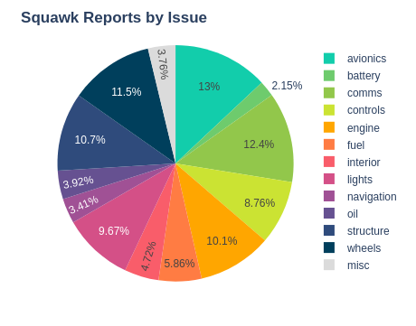
Pie Chart Visualization (Squawk Reports by Issue)

Slide 25
Overview of Squawk Report Distribution by Issue Category
An indicative measure of operational focus areas.
Avionics → 13%
Comms → 12.4%
Oil → 3.92%
Navigation →3.41%
A non-uniform distribution of issues
Avionics, wheels and controls necessitating heightened
attention but also with disproportionate high share of
the total reports.
Oil and navigation shows less frequency with nearly quarter
the percentage values of avionics and comms also with no proportionality.

Slide 26
A Detailed Examination of the Non-Uniform Distribution
Proportion of avionics-related issues:
High avionics reports could indicate system use complexity.
Potential need for more advanced training & maintenance protocols.
Consider investment in updated avionics to reduce frequency.
Controls-related issues:
Correlation with pilot error or system malfunction.
Review of pilot feedback for controls-related enhancements.
Impact of new control technologies on squawk report trends.
Less frequent issues:
Lower incidence of fuel issues may suggest robust system designs.
Rarity in lights-related reports could reflect lower operational impact or better system reliability.

Slide 27
Understanding Frequent Avionics and Controls
Avionics issue implications:
Increased avionics may correlate with high-tech cockpit enhancements.
Need for ongoing software updates and hardware checks.
Review of historical data to predict future avionics maintenance.
Controls issue investigation:
Examination of training procedures to mitigate mishandling.
Analysis of incident reports to improve design and ergonomics.
Integration of automated control systems to decrease human error.

Slide 28
Understanding Infrequent Fuel and Oil Reports
Rarity of fuel and oil reports assessment:
Comparison with industry benchmarks for fuel and oil system reliability.
Evaluation of sensor technology and early detection capabilities.
Investigation into under-reporting and impact on safety measures.
Significance of accurate reporting for flight safety:
Development of stricter reporting protocols for fuel and oil issues.
Enhancement of pilot training for early detection of such issues.
Implementation of more rigorous pre-flight and post-flight checks.

Slide 29
Temporal Trends in Comms and Nav Squawks
Time series analysis of trends:
Identification of peak periods for comms and nav squawks.
Cross-analysis with technological upgrades and system overhauls.
Assessment of the impact of environmental factors
Solar activity on navigation systems.
Wind Speed
External factors influencing trends:
Review of changes in air traffic communication protocols.
Correlation with global navigation satellite system (GNSS) updates.
Consideration of the introduction of next-gen air traffic control technologies.

Slide 30
Unpacking the 'Miscellaneous' Category
Diversity within 'Miscellaneous' category:
Review of classification protocols to reduce 'Miscellaneous' assignments.
Implementation of machine learning to analyze and categorize ambiguous reports.
Potential for creating new categories or subcategories for better tracking.
Accurate issue classification for insights:
Importance of detailed data for predictive analytics and maintenance planning.
Utilization of clustering algorithms to identify hidden patterns within 'Miscellaneous'.
Training of a supervised model with historical data to improve future categorization.

